Slide 1
We will get started shortly.
International Science Nutrition Society – CURARE CAUSAM - ISNS 2023

Slide 2
ISNS CASE STUDY
With Dr. Norbert Ketskes on Migraine Disease
International Science Nutrition Society – CURARE CAUSAM - ISNS 2023

Slide 3
Medical Disclaimer
The information provided is for educational purposes and is not intended as medical advice, or a substitute for the medical advice of a physician or other qualified health care professional. This is for science and educational purposes only and cannot be used in any aspect for sales or marketing. You should not use this information for diagnosing a health or fitness problem or disease. You should always consult with a doctor or other health care professional for medical advice or information about diagnosis and treatment. This is Confidential. Do not distribute—for scientific educational purposes only.
International Science Nutrition Society – CURARE CAUSAM - ISNS 2023

Slide 5
DR. NORBERT KETSKÉS, MD
Dr. Norbert Ketskés M.D. is one the most acknowledged gastroenterologist in Hungary, specializing in natural and organic nutritional solutions, leading the well-known Primus Labor, a private clinic offering personalized nutritional advices to its patients.
Scientific Adviser of ISNS
Medical Partner of the Hungarian Olympic Committee since 2015
Member of the Medical board of Hungarian Karate Association since 2015
Leader of the Primus Labor Private Medical Clinic since 2013
Working as a Family Doctor 1999 – 2012
International Science Nutrition Society – CURARE CAUSAM - ISNS 2023

Slide 6
CSISZTU ZSUZSA
Television - Presenter, Anchor, Editor, Journalist and Sports Lawyer, Sport-diplomat
Spokesperson of the Giro d’Italia Grande Partenza, (Road-Cycling World -Tour Championship)
Spokesperson of the FINA (Swimming and Waters poets World Championship)
2022 Vice-President of the Hungarian Sports Journalists’ Association
Member of the Hungarian Olympic Committee Member of the Advisory Board of the Hungarian Olympic Academy
Newly Elected Vice-President of the International Sports Journalists Association, the first female ever in the field from her homeland, and third globally since 1924 (AIPS)
International Science Nutrition Society – CURARE CAUSAM - ISNS 2023

Slide 7
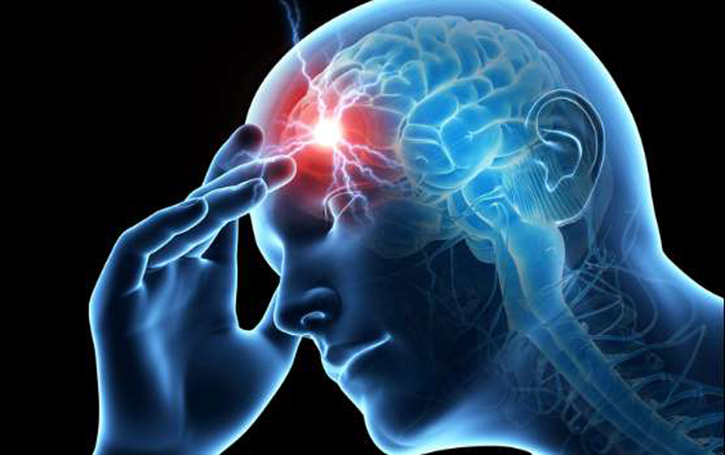
What is Migraine?
Migraine is a type of headache characterized by recurrent attacks of moderate to severe throbbing and pulsating pain on one side of the head.
The pain is caused by the activation of nerve fibers within the wall of the brain blood vessels traveling inside the meninges (three layers of membranes protecting the brain and spinal cord)
International Science Nutrition Society – CURARE CAUSAM - ISNS 2023

Slide 8
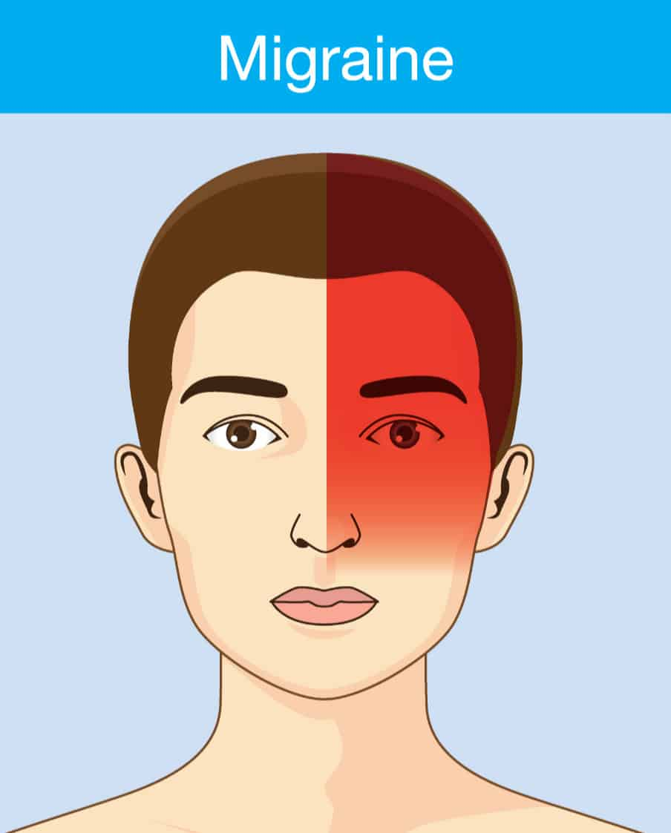
Migraines
A migraine is a common neurological disease that causes a variety of symptoms, most notably a throbbing, pulsing headache on one side of your head. Migraines tend to get worse with physical activity, lights, sounds, or smells. It may last at least four hours or even days.
About 12% of Americans have this genetic disorder. Research shows that it’s the sixth most disabling disease in the world.
International Science Nutrition Society – CURARE CAUSAM - ISNS 2023

Slide 9
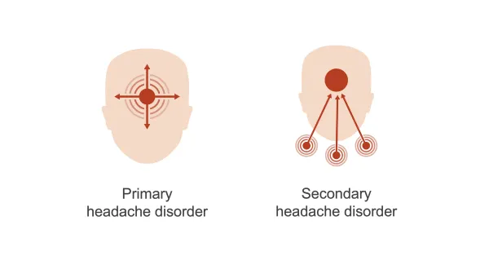
What type of headache is a migraine?
There are over 150 types of headaches, divided into two categories: primary headaches and secondary headaches. A migraine is a primary headache, meaning it is not caused by a different medical condition. Primary headache disorders are clinical diagnoses, meaning there is no blood test or imaging study to diagnose it.
A secondary headache is a symptoms of another health issue.
International Science Nutrition Society – CURARE CAUSAM - ISNS 2023

Slide 10
What is an Aura?
An Aura is a group of sensory, motor, and speech symptoms that usually act like warning signals that a migraine is about to begin. Commonly misinterpreted as a seizure or stroke, it typically happens before the headache pain, but sometimes appears during or after. An aura can last from 10 to 60 minutes. Aura symptoms are reversible, meaning that they can be stopped/healed. An aura produces symptoms that may include:
Seeing bright flashing dots, sparkles or lights
Blind spots in your vision
Numb or tingling skin
Speech changes
Ringing in your ears (tinnitus)
Temporary vision loss
Seeing wavy or jagged lines
Changes in smell or taste
A “funny” feeling
International Science Nutrition Society – CURARE CAUSAM - ISNS 2023

Slide 11
Types of Migraines
There are several types of migraines, and the same type may go by different names:
Migraine with aura (complicated migraine: around 15-20% of people with migraine headaches experience aura.
Migraine without aura (common migraine): this type of migraine headache strikes without the warning an arura may give you. The symptoms are the same, but that phase does not happen
Migraine without head pain: “silent migraine” or acephalgic migraine,” as this type is also known as, includes aura symptom but not the headache that typically follows
Hemiplegic Migraine: You may have temporary paralysis (hemiplegia) or neurological or sensory changes on one side of your body. The onset of the headache may be associated with temporary numbness, extreme weakness on one side of your body, a tingling sensation. Sometimes it includes head pain and sometimes it does not.
Retinal Migraine (ocular migraine): You may notice a temporary, partial or complete loss of vision in one of your eyes, along with a dull headache behind the eye that may spread to the rest of your head. You should always report a retinal migraine to your doctor as it could be a sign of a more serious issue
Chronic Migraine: a chronic migraine is when a migraine occurs at least 15 days per month. The symptoms may change frequently, and so may the severity of pain.
Migraine with Brainstem Aura: with this migraine, you will have vertigo, slurred speech, double vision or loss of balance, which occur before the headache. The headache pain may affect the back of your head.
Stratus Migrainosus: this is a rare and severe type of migraine that can last longer than 72 hours. The headache pain and nausea can be extremely bad.
International Science Nutrition Society – CURARE CAUSAM - ISNS 2023

Slide 12
Four Stages or Phases of Migraine
The four stages in order are the prodrome (pre-monitory), aura, headache and postdrome. About 30% of people experience symptoms before their headache starts.
Prodrome: the first stage lasts a few hours, or it can last days. You may or may not experience it as it may not happen every time. Some know it as a “preheadache” or “premonitory” phase
Aura: the aura phase can last as long as 60 minutes or as little as five. Most people don’t experience an aura, and some have both the aura and the headache at the same time.
Headache: about four hours to 72 hours is how long the headache lasts. The word “ache” doesn’t do the pain justice because sometimes it’s mild, but usually, it’s described as drilling and throbbing, or you may feel the sensation of an icepick in your head. Typically, it starts on one side of your head and then spreads to the other side.
Postdrome: the postdrome stage goes on for a day or two. It’s often called a migraine “hangover” and 80% of those who have migraines experience it.
It can take about 8-72 hours to go through all four stages.
International Science Nutrition Society – CURARE CAUSAM - ISNS 2023

Slide 13
Causes of Migraines
Though migraine causes aren’t fully understood, genetics and environmental factors appear to play a role.
There are several migraine triggers, including:
Hormonal changes in women: fluctuations in estrogen, such as before or during menstrual periods, pregnancy, and menopause, seem to trigger headaches in many women
Hormonal medications, such as oral contraceptives, also can worsen migraines. Some women, however, find that their migraines occur less when taking these medications.
Drinks: these include alcohol, especially wine, and too much caffeine, such as coffee
Stress: stress at work or home can cause migraines
Sensory stimuli: bright or flashing lights can induce migraines, as can loud sounds. Strong smells- such as perfume, paint thinner, secondhand smoke, and others– trigger migraines in some people
Sleep changes: missing sleep or getting too much sleep can trigger migraines in some people
Physical factors: intense physical exertion, including sexual activity, might provoke migraines
Weather changes: a change of weather or barometric pressure can prompt a migraine
Medications: oral contraceptives and vasodilators, such as nitroglycerin, can aggravate migraines
Foods: aged cheeses and salty processed foods might trigger migraines. So might skipping meals
Food additives: These include the sweetener aspartame and the preservative monosodium glutamate (MSG), found in many foods.
International Science Nutrition Society – CURARE CAUSAM - ISNS 2023

Slide 14
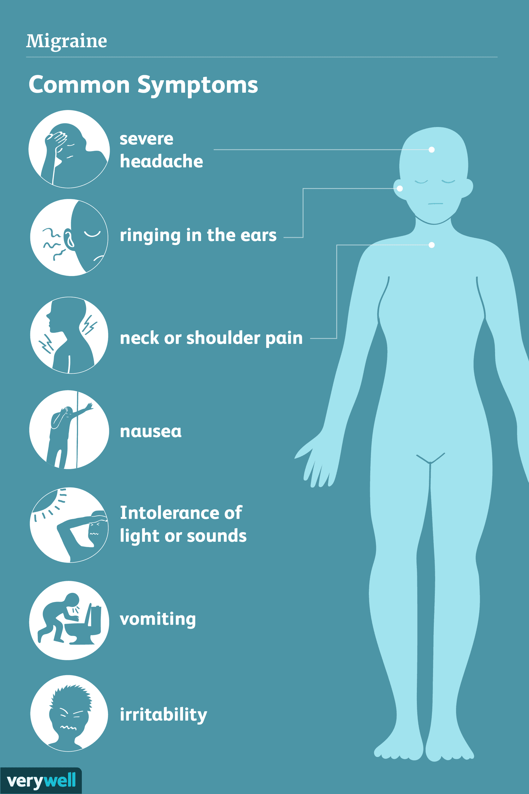
Symptoms of Migraines
The primary symptom of migraine is a headache. Pain is sometimes described as pounding or throbbing. It can be a dull ache that develops into pulsing pain that is mild, moderate, or severe. If left untreated, your headache pain will become moderate to severe. Pain can shift from one side of your head to the other, or it can affect the front of your head, the back of your head, or feel like it’s affecting your whole head. Some people feel pain around their eyes or temple, sometimes in their faces, sinuses, jaw, or neck. Other symptoms of migraine headaches include:
Sensitivity to light, noise, and odors
Nausea and vomiting, upset stomach, and abdominal pain
Loss of appetite
Feeling very warm (sweating) or cold (chills)
Pale skin color (pallor)
Feeling tired
Dizziness and blurred vision
Tender scalp
Diarrhea (rare)
Fever (rare)
Most migraines last about 4 hours, although severe ones can last much longer.
International Science Nutrition Society – CURARE CAUSAM - ISNS 2023

Slide 15
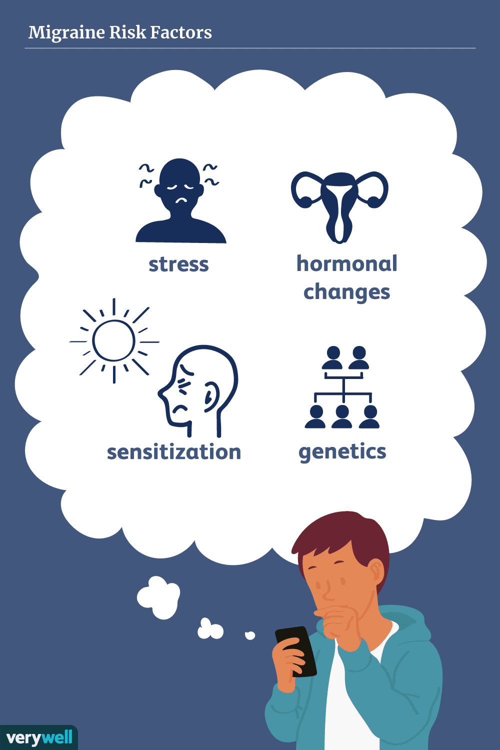
Risk Factors
Several factors make you more prone to having migraines, including:
Family history – if you have a family member with migraines, then you have a good chance of developing them too
Age – Migraines can begin at any age, though the first often occurs during adolescence. Migraines tend to peak during your 30’s, and gradually become less severe and less frequent in the following decades.
Sex– women are three times more likely than men to have migraines
Hormonal changes - for women who have migraines, headaches begin just before or shortly after the onset of menstruation. They might also change during pregnancy or menopause. Migraines generally improve after menopause
International Science Nutrition Society – CURARE CAUSAM - ISNS 2023

Slide 16
CASE STUDY
Patient: Female
Age: 38 years old
History: Her mother also suffers from migraine
Medical history:
She has been having migraine attacks for 5 years.
She had attacks several times (2-3) a month, they last 2-3 days.
Symptoms:
Throbbing pain on the right side of her head,
nausea, vomiting,
sensitivity to light and sound during the migraines.
She finds it difficult to concentrate or perform any activities during the migraines, which negatively impacts her work and daily life.
Clinical tests:
Neurological exam
MRI scan
Blood tests
International Science Nutrition Society – CURARE CAUSAM - ISNS 2023

Slide 17
Conventional Treatment
Migraine treatment is aimed at stopping symptoms and preventing future attacks.
Many medications have been designed to treat migraines. Medications used to combat migraines fall into two categories:
Pain-relieving medications: also known as acute or abortive treatment, these types of drugs are taken during migraine attacks and are designed to stop symptoms.
Preventative medications: these types of drugs are taken regularly, often daily to reduce the severity or frequency of migraines
Treatment choices depend on the frequency and severity of your headaches, whether you have nausea and vomiting with your headaches, how disabling your headaches are, and other medical conditions you have
Medications used to relieve migraine pain work best when taken at the first sign of an oncoming migraine- as soon as signs and symptoms of migraine begin. Medications that can be used include pain relievers, triptans, CGRP antagonists, opioid medications, and anti-nausea drugs
Headache diary
She's regular diary helped her identify triggers that aggravate migraine attacks, such as excessive caffeine intake, stressful situations and lack of sleep. She has managed to develop a lifestyle that minimises these triggers. Despite this, her migraine attacks have not significantly reduced.
International Science Nutrition Society – CURARE CAUSAM - ISNS 2023

Slide 18
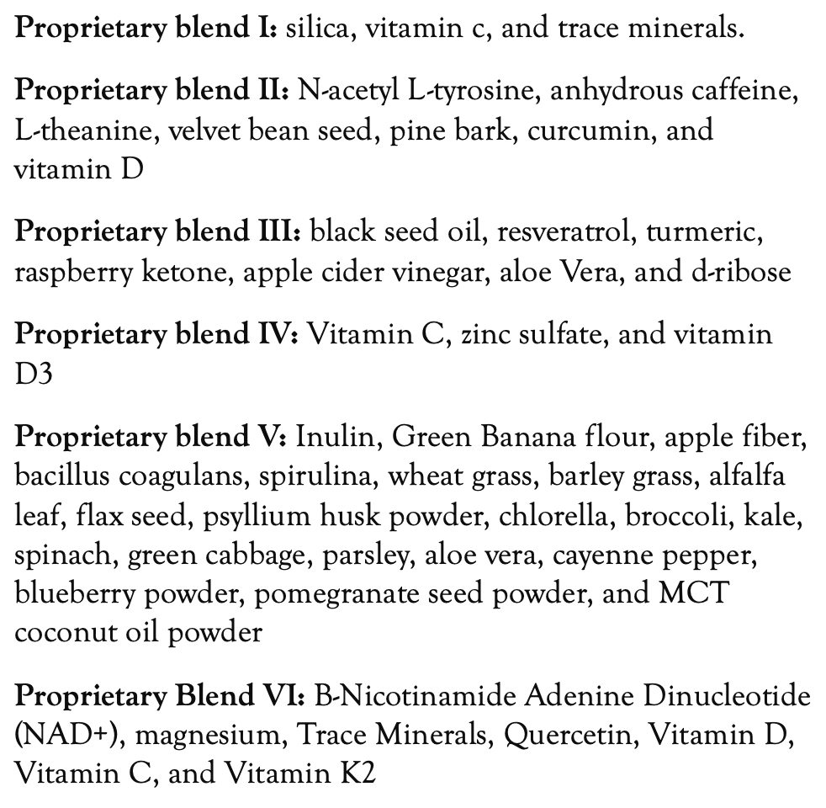
Method
PROPRIETARY BLENDS LEGEND
Proprietary blend I: 2x6 drops, morning and
evening, for 3 days, then every 3 days then
increased by 1-1 drops every 3 days to 2x10
Proprietary blend II :1 in the morning for 7 days, then 1 in the morning and 1 in the afternoon for 7 days, then 2 in the morning and 1 in the afternoon
Proprietary blend III: 1/2 sachet in the morning
for 7 days then 1 sachet in the morning
Proprietary blend IV: 1/2 teaspoon in the
morning
Proprietary blend V: 1 teaspoon in the
in the evening
Proprietary blend VI: 1 in the
morning for 7 days then 1 in the morning and 1 in the evening
International Science Nutrition Society – CURARE CAUSAM - ISNS 2023

Slide 19
Seizure Treatment (as early as possible during the aura period, in any case before the onset of the headache)
Proprietary blend I: 1x10 drops
Proprietary blend II :2 capsules
Proprietary blend III: 1 sachet
Proprietary blend IV: 1/2 teaspoon
International Science Nutrition Society – CURARE CAUSAM - ISNS 2023

Slide 20
Results
After 1 months:
The intensity of symptoms during attacks has decreased.
(throbbing pain, nausea, vomiting, sensitivity to light and sound)
Seizure treatment!!
After 2 months:
The intensity of symptoms during attacks has further decreased.
The frequency of attacks has also decreased (only 2 weeks)
After 3 months:
The nausea and vomiting stopped, the throbbing nature of the headache stopped!
In the third month, there was 1 attack which resolved in a few hours!
International Science Nutrition Society – CURARE CAUSAM - ISNS 2023

Slide 21
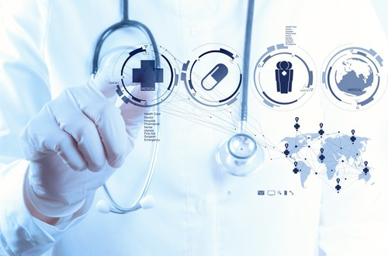
Research Studies
International Science Nutrition Society – CURARE CAUSAM - ISNS 2023

Slide 22
Effects of Curcumin Supplementation on Clinical Features and Inflammation, in Migraine Patients: A Double-Blind Controlled, Placebo Randomized Clinical Trial Sheyda Rezaie, Gholamreza Askari, Fariborz Khorvash, Mohammad Javad Tarrahi, and Reza Amani
This randomized double-blind placebo-controlled clinical trial was carried out on 44 women with migraine, receiving either 500 mg curcumin twice a day or placebo supplements for 8 weeks. Serum CGRP and IL-6 concentration, and clinical symptoms including headache severity, duration and frequency were measured at the baseline and end of study.
After 8-week intervention, compared with placebo, curcumin supplementation led to significand reduction in CGRP (P < 0.001), IL-6 (P = 0.041), severity (P = 0.001), and duration of headache (P = 0.007).
Headache frequency showed marginal improvement in curcumin group, compared to controls (P = 0.052).
Curcumin supplementation improved the pro-inflammatory markers and clinical features of migraine headaches and that could be contributed to could be to its anti-inflammatory properties.
https://www.ncbi.nlm.nih.gov/pmc/articles/PMC8724631/
International Science Nutrition Society – CURARE CAUSAM - ISNS 2023

Slide 23
Vitamin C Supplementation as Possible Prophylactic Treatment against Migraine with Aura and Menstrual Migraine Munvar Miya Shaik and Siew Hua Gan
Vitamin C can also be used as a scavenger of reactive oxygen species for treating neurogenic inflammation in migraine patients. This paper reviews possible therapies based on vitamin supplementation for migraine prophylaxis, focusing on migraine with aura and menstrual migraine.
Migraines may be considered a “complex regional pain syndrome of the brain,” with neurogenic inflammation and ROS generation as common mechanisms. Because vitamin C significantly reduces the risk of CRPS after injury, it may also act as a prophylactic agent against migraine.
A randomized controlled trial investigating the hypothesis that the administration of 1,000 mg of vitamin C daily will reduce the incidence and severity of migraine attacks is urgently needed, as vitamin C is a cheaper alternative and has relatively fewer side effects than other drugs used for migraine treatment.
https://www.ncbi.nlm.nih.gov/pmc/articles/PMC4359851/
International Science Nutrition Society – CURARE CAUSAM - ISNS 2023

Slide 24
References
https://www.mayoclinic.org/diseases-conditions/migraine-headache/symptoms-causes/syc-20360201
https://www.ninds.nih.gov/health-information/disorders/migraine
https://www.ncbi.nlm.nih.gov/pmc/articles/PMC8724631/
https://www.ncbi.nlm.nih.gov/pmc/articles/PMC4359851/
International Science Nutrition Society – CURARE CAUSAM - ISNS 2023

Slide 25
Thank You for Joining Us This Week!!
International Science Nutrition Society – CURARE CAUSAM - ISNS 2023

